Slide 1
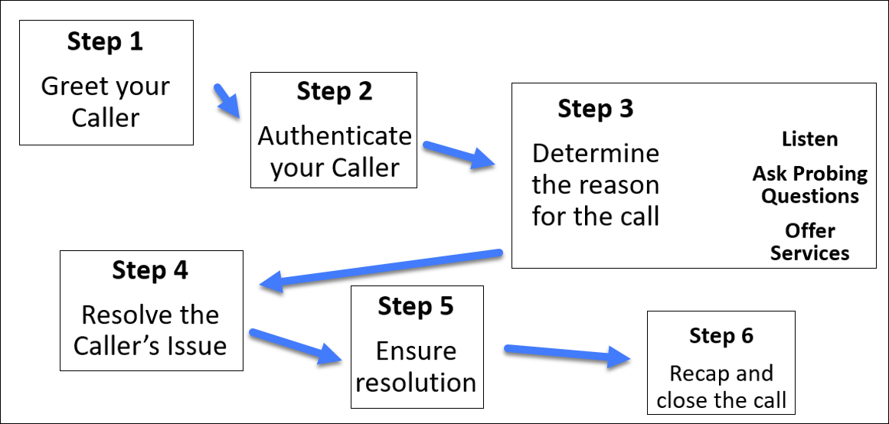








Basic Call Flow Infographic

